Slide 1


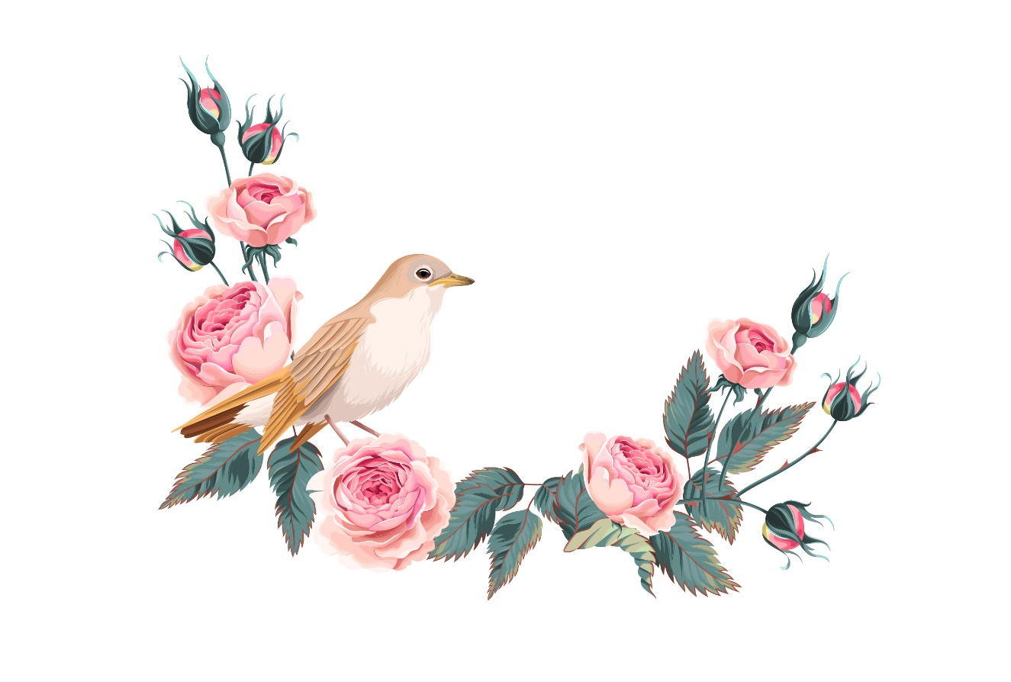
The Nightingale and the Rose
Unit 4 (2)
Summary & Discussion
Vocabulary
Translation skill
Exercises

Slide 2



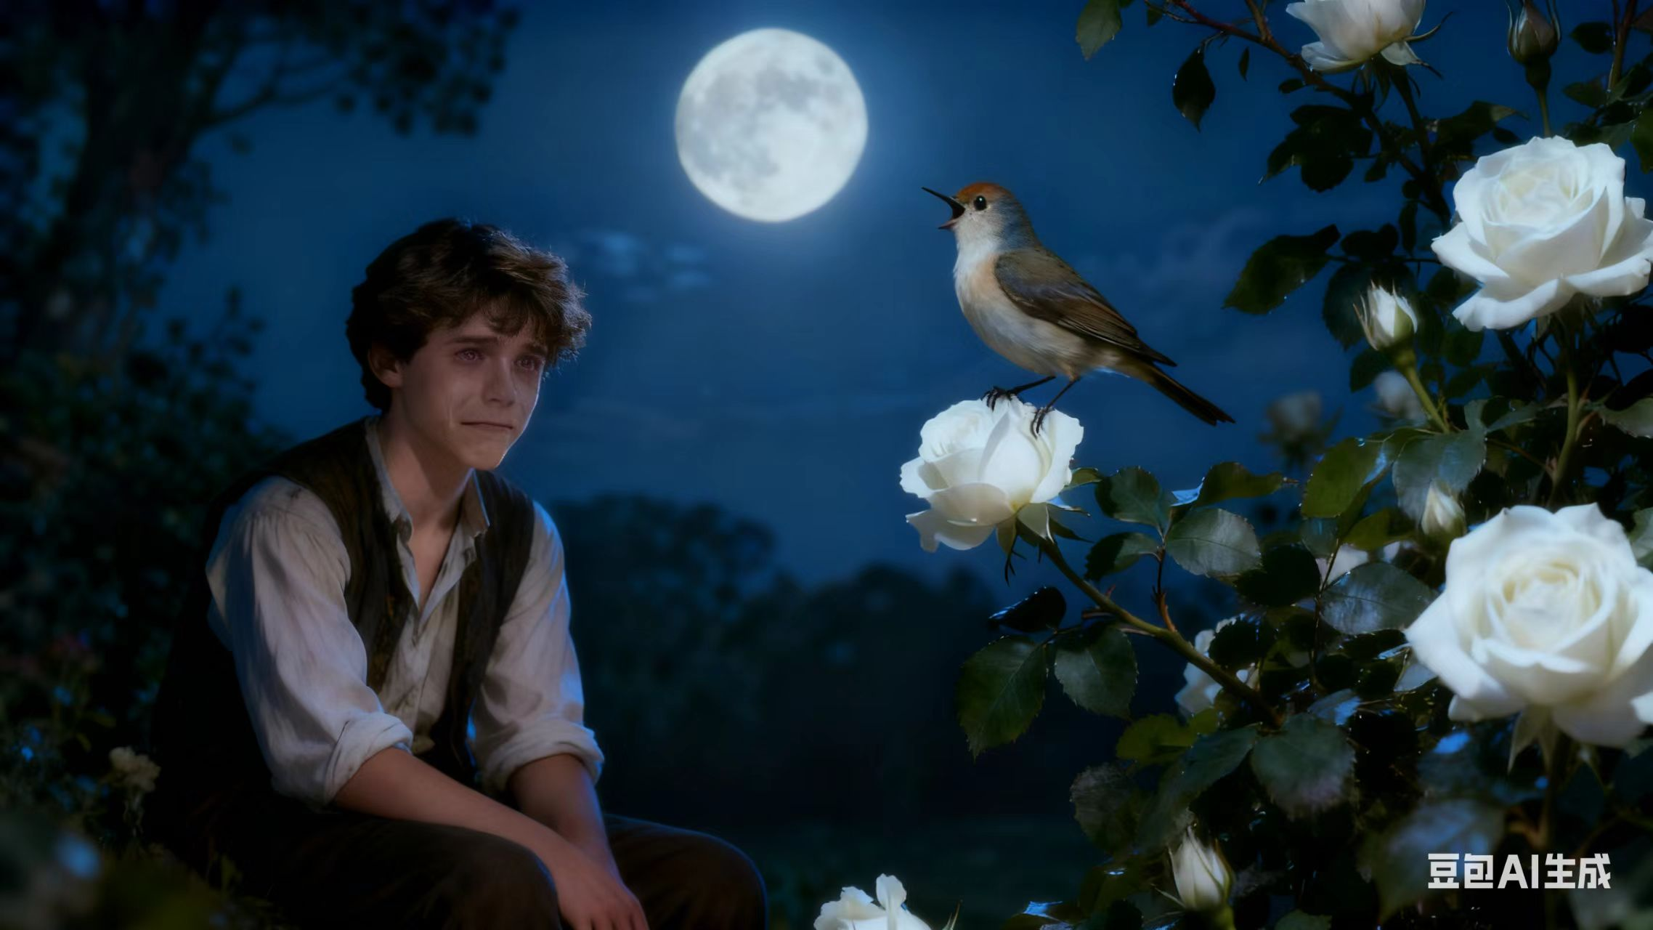
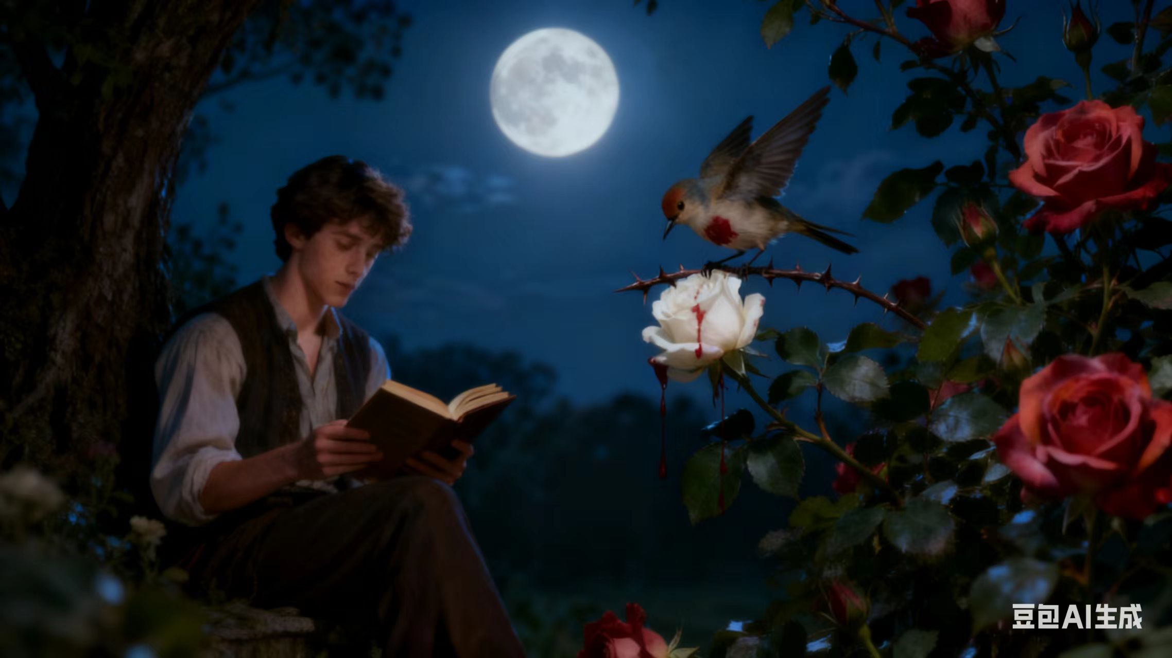
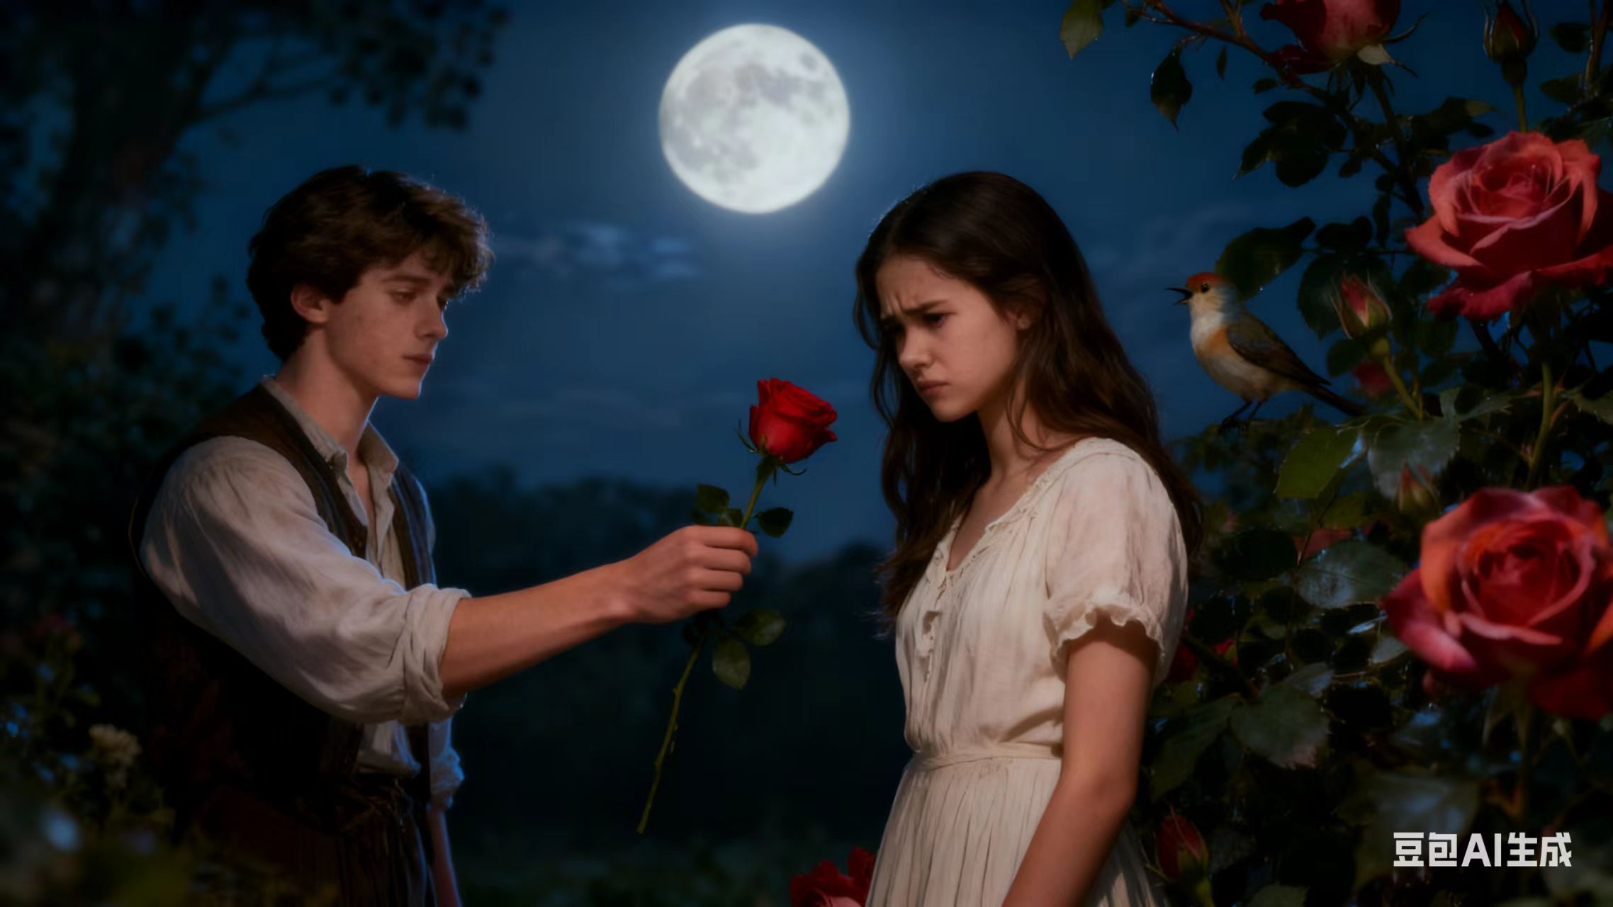
Summary
Retell the story and talk about the theme of the story.
Satire(讽刺) on the materialistic and rationalistic view on love.
Conflict between cynical, practical values and idealistic love.
The author’s art is ultimately unappreciated by a shallow world.

Slide 3
Discussion
Discuss about the following questions within your group, and one group member reports your discussion to the class.
1. What do you value most in a partner (girlfriend /boyfriend)? Put the following 5 aspects in order according to their importance in love:
appearance, personality, talent,
taste, common hobbies
2. What’s your favourite love story/movie/TV dramas? Why do you like it?
3. How do you define “true love”?

Slide 4
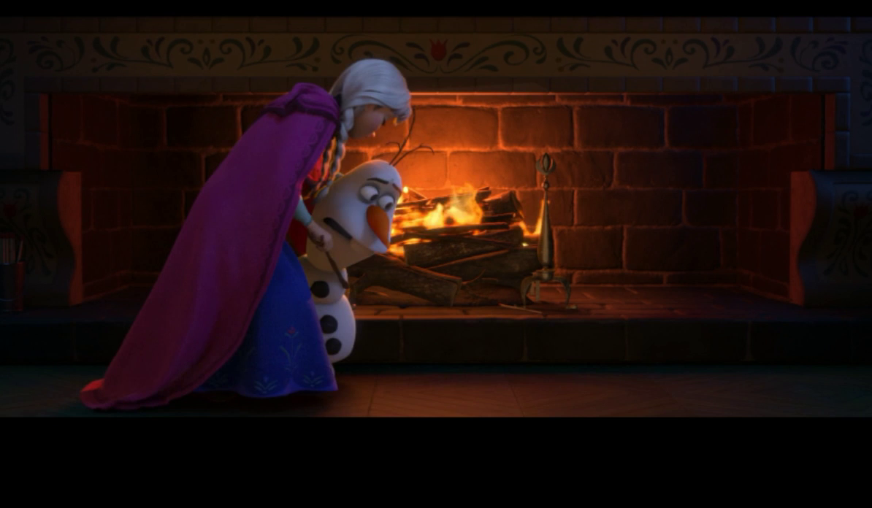
Discussion
How do you define “true love”?

Slide 5
Glossary
bridegroom ecstasy flutter harp lean meadow mystery wretched
harp
meadow
ecstasy
wretched
bridegroom
mystery
lean
flutter

Slide 6
Glossary
Fill in each blank with the best word from the given words.
bloom bubble deny ebb faint linger nip soar
deny
1. No one can ________ that climate change is a pressing issue.
2. There is a ________ hope that they might be alive after the plane crash.
3. Linda’s enthusiasm began to _______ away few people listened to her.
4. During the Renaissance, art and science were in full ________.
5. News of the defeat quickly burst the ________ of our self-confidence.
6. They ________ over coffee until around midnight.
7. Due to the war in Middle East, the price of petrol has ________ recently.
8. We need to _______ this kind of bad behavior in the bud.
faint
ebb
bloom
蓬勃发展，处于鼎盛
bubble
lingered
soared
nip
猛增，飞涨
nip sth. in the bud 将……扼杀在萌芽状态

Slide 7
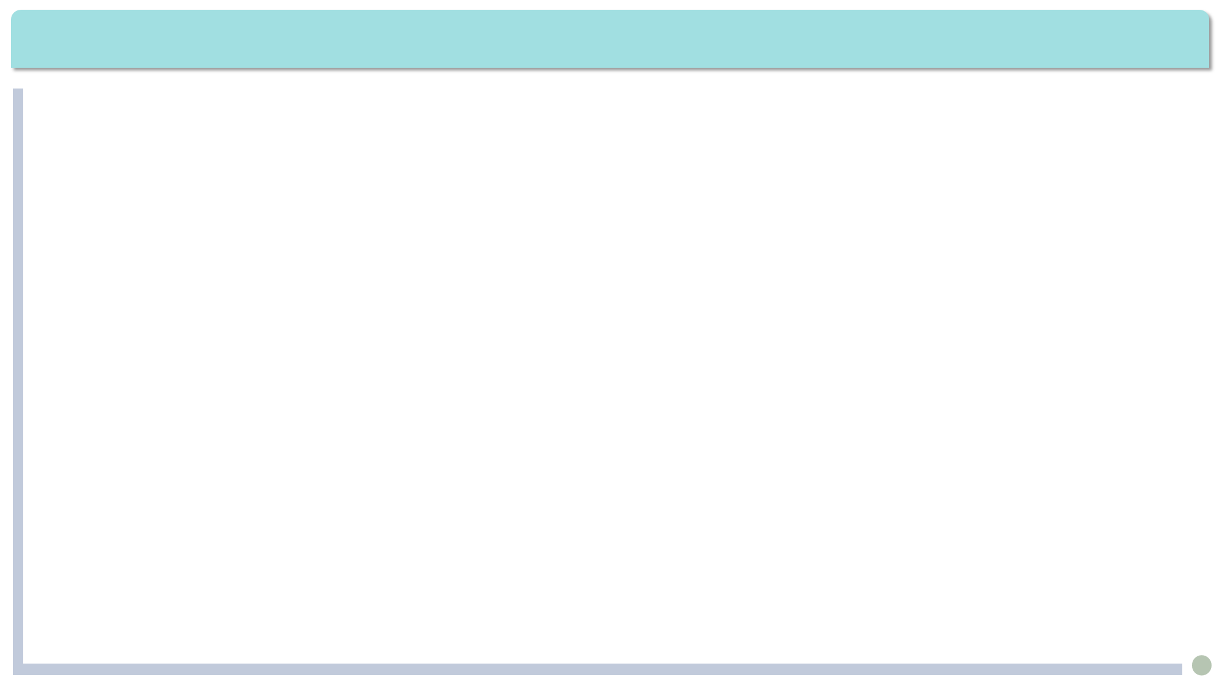
Exercises · Language Exercises
2. Fill in the blanks with the correct form of the words in the brackets.
1) He, too, was a naturalist, as well as a farmer, inventor, _________ (history),writer,
and politician.
2) In an ideal society, all people have an equal opportunity for _____________ (employ).
3) Not only was Einstein a world famous _______ (science), he was also a fairly good _______ (violin).
4) The value of an idea has nothing whatsoever to do with the _______ (sincere) of the man who expresses it.
historian
employment
scientist
violinist
sincerity

Slide 8
Exercises · Language Exercises
2. Fill in the blanks with the correct form of the words in the brackets.
5) The police were not _______ (arm) and the protesters were also ________ (peace).
6) I am still ________ (puzzle) by the ____________ (philosophy) question: Which
comes first, the chicken or the egg?
7) She's recovering __________ (remark) well from her operation, though she is still a
little _____ (shake) on her feet.
8) It’s ________ (amaze) that tractors are used today even in ___________ (mountain) areas.
armed
peaceful
puzzled
philosophical
remarkably
shaky
amazing
mountainous

Slide 9
Exercises · Language Exercises
3. Translate the following expressions, paying attention to the meaning of the past participle.
1) a frozen river 6) at a reduced price
2) written document 7) returned overseas Chinese
3) a satisfied look 8) a well-planned move
4) a respected professor 9) broken home
5) a forced smile 10) dried fruit
冰封的河流
压低的价位
书面文件
归国华侨
满意的表情
深谋远虑的举动
一位受尊敬的教授
破裂的家庭
苦笑
干果

Slide 10
Exercises · Language Exercises
3. Translate the following expressions, paying attention to the meaning of the
past participle
11) a preserved egg 16) canned food
12) the above-mentioned reasons 17) in a finished form
13) a prepared speech 18) an experienced teacher
14) boiled water 19) the enemy-occupied areas
15) retired workers 20) a lost battle
一枚松花蛋
罐头食品
上述各理由
已经完成的形式
事先准备好的讲话
一位有经验的老师
开水
敌占区
退休工人
一场输掉的战斗

Slide 11
Exercises · Language Exercises
Translate the following expressions, paying attention to the verb pattern V.+ I.O.+ D.O.
Into Chinese
1) sing us a song 6) order me a cup of coffee
2) bring me a rose 7) deny her nothing
3) buy her a book 8) spare me a few minutes
4) write her a letter 9) cook us a wonderful meal
5) pass me the salt 10) get me a new pair of shoes
给我们唱一首(歌)
给我点一杯咖啡
给我带一朵玫瑰花来
她要什么就给什么，从不拒绝她
给她买本书
给我几分钟时间
写封信给她
为我们做一顿美餐
把盐递给我
给我弄一双新鞋

Slide 12
Exercises · Language Exercises
Translate the following expressions, paying attention to the verb pattern V.+ I.O.+ D.O.
Into English
1) 为我省很多时间 (save) 6) 为他们造一间漂亮的房子(build)
2) 给你造成了不少麻烦 (cause) 7) 向他付清你所有的债款 (pay)
3) 给她留个小条子 (leave) 8）为她找到一条新出路 (find)
4) 答应和我们好好合作 (promise) 9）把他的新车借给我 (lend)
5) 要你赔上你的性命(cost)
save me a lot of time
build them a beautiful house
cause you a lot of trouble
pay him all your debts
leave her a little note
find her a way out
promise us good cooperation
lend me his new car
cost you your life

Slide 13

Exercises · Language Exercises
2. Fill in the blanks with the correct prepositions or adverbs.
1. _____ want of a better word, let's call them “professional sleepers” because it is their job to sleep _____ hotel beds and test out their quality.
2. It was growing dark outside. She pressed her face _______the window and looked _____ . She found that it had started snowing.
3. By that time, many of them were half drunk, and they were all dancing _____the music _____ complete ecstasy.
4. He refused to have his hands stained ______ the blood of innocent people. the soldier's honor was dearer _____ him than his own life.
For
in
against
out
to
in
with
to

Slide 14

Exercises · Language Exercises
2. Fill in the blanks with the correct prepositions or adverbs.
5. I went to my uncle, who was fond _____ me, for help. He was something ____ a doctor. He spread some stuff _____ my wound and assured me that the pain would be gone in no time. But two weeks later my pain still lingered _____.
6. _____my mind, it was Su Dongpo who wrote the most memorable poem that sings _____ the beautiful moon.
7. It was a lovely painting, showing a young woman holding a little baby ____ her arms, bursting _____ love.
8. Our grandparents keep telling us that our life is much better now compared _____ theirs when they were our age, and we shouldn't be ungrateful ____ all those who have helped to make it possible.
of
of
on
on
To/In
of
in
with
with
to

Slide 15
Exercises · Language Exercises
3. Fill in the blanks with the correct form of the appropriate phrases with “go” in the brackets. Note that more than one of them may be appropriate.
1. Let us _______ (go about处理；从事; go over仔细检查) our plan more carefully. We can‘t afford to let anything go wrong.
2. It was freezing. No wonder. The fire ________ (go off; go out) in the middle of the night.
3. There must be something mysterious _______ (go around; go on) on the earth. Look at the strange weather we've been having these days.
4. In a state of crisis, it is usually the weak that ________________ (go down; go under失败，被摧毁) first, which _______ (go for适用于; go to) nations as well as individuals.
go over
went out
going on
go down/ go under
goes for

Slide 16
Exercises · Language Exercises
3. Fill in the blanks with the correct form of the appropriate phrases with “go” in the brackets. Note that more than one of them may be appropriate.
5. Claire said she didn‘t feel like going swimming. She suggested we _____ (go for; go to) the rock concert. I don‘t usually _____ (go for选择; go to) rock music, but I decided to ___________________ (go with; go along with) her this time. It turned out to be quite an experience. The audience just __________(go crazy; go crazily).
6. The color of your tie doesn‘t _______ (go along with; go with) your shirt. Red and pink just don't match.
7. If past experience is anything to _____ (go by遵照; go to), he‘ll definitely _______ (go after追求; go at) Jane's position when she leaves.
go to
go for
go along with / go with
went crazy
go with
go by
go after

Slide 17
Exercises · Language Exercises
3. Fill in the blanks with the correct form of the appropriate phrases with “go” in the brackets. Note that more than one of them may be appropriate.
8. I must warn you. Fireworks ______ (go off爆炸; go up) easily. Your job is risky. You must _____ (go to尝试解决; go at) it with great care.
9. I am afraid I cannot ______(go by; go for) that plan, because it _________ (go for; go against) everything I believe in.
10. The mainframe computer of the company _____________(go down出故障; go out), and it is not possible for the company to ________ (go on; go about) its business as usual.
go off
go at
go for
go against
has gone down
go about

Slide 18
Exercises · Language Exercises
4. Fill in the blanks with the correct form of the appropriate words or phrases in the brackets. Note that more than one of them may be appropriate
1. She was _____ (alone; lonely), but she was not ______ (alone; lonely). In fact, she just wanted people to leave her _____ (alone; lonely).
2. Did you notice the building _______________ (shiver; tremble; shake) just now?
3. The night was extremely cold. We were all ________________ (shiver; tremble; shake).
4. _____ (shake; shiver; tremble) the bottle before you take the medicine.
alone
lonely
alone
trembling / shaking
shivering / shaking
Shake

Slide 19
Exercises · Language Exercises
4. Fill in the blanks with the correct form of the appropriate words or phrases in the brackets. Note that more than one of them may be appropriate
5.It ______ (spend; cost; take) us a long time to realize that a good government must ____ (first; at first) make sure that its people are free from _____(want; need).
6. ______ (first; at first) we had to import all the oil we needed from foreign
countries. Then we found the big oil field in Daqing. For a time we thought our energy problem had been solved ______ (last; at last).
7. It was early spring. The sun was shining, and the ________ (lawn; meadow) were flowering, and the peach trees were in full _______(bloom; flower).
took
first
want
At first
at last
meadows
bloom

Slide 20
Exercises · Language Exercises
4. Fill in the blanks with the correct form of the appropriate words or phrases in the brackets. Note that more than one of them may be appropriate
8. He ______ (spend; cost; take) quite some time looking for the right kind of _______ (blossom; bloom; flower) for his mother's birthday.
9. I bought these shoes _____________ (cheap; cheaply). They only ______ (cost; spend) me three hundred yuan.
10. It is a truth universally acknowledged that a single man in possession of a large fortune must be _________ (for want of; in want of) a wife.
spent
flowers
cheaply/cheap
cost
in want of

Slide 21
Exercises · Language Exercises
5. Translate the following sentences, paying attention to the words in bold type which may have different meanings in different contexts.
His fans went almost crazy that night in the ballroom. Some young girls even fainted.
那天晚上舞厅里他的崇拜者们(粉丝)几乎都发狂了。有些年轻女孩子都昏 了过去。
2. This film must have been set in the old days for people in it were still using electric fans.
这部电影一定是以过去为背景的，因为电影里人们还在用电扇。
3. I always enjoy watching a good ball game, but I do not usually lean to any particular side. A ball game is a ball game.
我一直很喜欢看精彩的球赛，但是我一般不专门站在哪一边。球赛就是球赛。

Slide 22
Exercises · Language Exercises
5. Translate the following sentences, paying attention to the words in bold type which may have different meanings in different contexts.
4. This world-famous big game hunter left most of his savings in his will to a wildlife protection organization. He only left a little for his son to help against any lean years.
这位世界闻名的大型动物猎人在他的遗嘱里把大部分积蓄都留给了一个野生动物保护组织。他只给儿子留了一点点，以帮他渡过困难的岁月。
5. A man convinced against his will is not really convinced. We should let everybody air their views freely.
一个人被迫表示被说服并不是真正被说服。我们要让每个人畅所欲言，自由发表他们的意见。

Slide 23
Exercises · Language Exercises
5. Translate the following sentences, paying attention to the words in bold type which may have different meanings in different contexts.
6. The old man leaned his stick against the wall. He had the air of a wealthy gentleman.
那个老人把他的拐杖靠墙一放，他的风度很像一个有钱的绅士。
7. The secretary was a lean, sweet, elderly woman who invited me to sit down with a sweet smile and asked me to fill out a form.
那位秘书是一个瘦瘦的可爱的老太太。她朝我甜美地笑了笑，请我坐下，然后叫我填一份表。

Slide 24
Exercises · Language Exercises
5. Translate the following sentences, paying attention to the words in bold type which may have different meanings in different contexts.
8. In the middle of the desert we found a nameless flower which smelt faintly sweet and tasted a bit sweet, too.
我们在沙漠深处发现一种无名小花，它有一股淡淡的香味，放在嘴里还有一丝甜味。
9. I sprayed pesticides on the trees early this morning which formed a thin film on the leaves.
我今天一早给这些树喷洒了杀虫剂，这些树的叶子上就形成了一层薄膜。

Slide 25
Exercises · Language Exercises
6. Study the following examples and complete the sentences by translating the Chinese in the brackets.
Example 1
She will dance so lightly that her feet will not touch the floor. (para. 7)
1. He loved his hometown so much ____________________________________
_______________________________________________（以至于他决定毕业以后就回去终身当乡村教师）.
2. The king was so corrupt and unpopular _________________________ （以至于他很快就失去了权力）.
3.China has grown so much in its influence ______________________________
____________________________________________________________________（以至于人们通常都认为中国的参与能更好地解决世界上的很多问题）.
that he decided to devote his whole life to
teaching in his home village after he finished school
that he soon lost his power
that people generally agree/feel that
many problems in the world can be better resolved with its participation/involvement

Slide 26
Exercises · Language Exercises
6. Study the following examples and complete the sentences by translating the Chinese in the brackets.
Example 2
“Why is he weeping?” asked a green Lizard, as he ran past him with his tail in the air. (para.8)
4. Right behind the door stood a man____________________（手上拿着枪）.
5. Scholars believe that___________________________________________ ___________________________________________ （随着大象数量的增加，以及越来越多的茶树和橡胶树入侵它们的家园）, these elephants are forced to abandon their home.
6.____________________________________________________________________（前面是咆哮的河流，后面是追兵）, we were in a dangerous situation.
with a gun in his hand
with their number increasing and their home
invaded by more and more tea and rubber trees
With the roaring river in front and the enemy soldiers following closely behind

Slide 27
Exercises · Language Exercises
6. Study the following examples and complete the sentences by translating the Chinese in the brackets.
Example 3
... in this age to be practical is everything... (para.52)
7. Right at that moment _____________（保持镇静） was the most important thing.
8.（当一个教授就是要） _______________________ to know something about everything and everything about something.
9.（知道很多过去的名字、人物、事件并不意味着）___________________________ _________________________________________________ to know history .
to keep calm
To be a professor means
To know a lot of names,
people, and events in the past alone is not necessarily

Slide 28
Exercises · Language Exercises
6. Study the following examples and complete the sentences by translating the Chinese in the brackets.
Example 4
Pattern: all/everything/something/anything/nothing + that + relative clause
Ah, I have read all that the wise men have written...(para.3)
Everything that is enjoyable and beneficial is here. (para. 12,Text A, Unit 1)
10. _______________________________（医生作了最大努力） to save the injured miners.
11. In those years, _____________________________________（他辛勤劳动所得） was hardly enough to feed the family.
12. We'll take seriously___________________________________________________ （知道很多过去的名字、人物、事件并不意味着）.
The doctors did all (that) they could
all (that) he got for his hard work
everything (that) you’ve suggested in the report

Slide 29
Exercises · Language Exercises
6. Study the following examples and complete the sentences by translating the Chinese in the brackets.
Example 4
Pattern: all/everything/something/anything/nothing + that + relative clause
Ah, I have read all that the wise men have written...(para.3)
Everything that is enjoyable and beneficial is here. (para. 12,Text A, Unit 1)
13. _______________________________________（能做到的都已经做了）, but the patient has shown no signs of improvement.
14. Each human being is born as something new: __________________________ ______________________________________（一种以前不存在、未来也无法复制的东西）.
15. The vase has broken into so many pieces that there is _____________________________________________________________ （最好的匠人也无力修复了）.
All that can be done is being/has been done
something that never existed
before and cannot be repeated after
nothing (that) even the best craftsman can do to repair it

Slide 30
Exercises · Language Exercises
8. Translate the following sentences, using the words in the brackets.
1. 这是一个难得的机会。你要是让它从身边溜掉就太傻了！(slip)
This is a wonderful opportunity. You would be foolish to let it slip by.
2. 因为没有足够的补给，登山者们本次只能放弃，等待明年重来。(want)
For want of adequate supplies, the mountain climbers had to give up this time and wait to come back next year.
3. 这说来话长，但是今天我不想去研究这件事情的历史了。(go)
It’s a long story, but I won’t go into its history today.
4.他气得脸色发青，决定将这场阴谋扼杀在萌芽状态。(nip)
His face went/turned blue with anger. He was determined to nip the conspiracy/plot in the bud.

Slide 31
Exercises · Language Exercises
8. Translate the following sentences, using the words in the brackets.
5. 他回家很久后，美妙的音乐仍在耳边回响！ (linger)
Long after he returned home, the beautiful music still lingered on in his ears.
6. 与其他工业化城市相比，这个城市污染最少。(compare)
Compared with other industrialized cities, this city is the least polluted.
7. 尽管有多次失败，她的决心和热情却依然不变，毫不消退。(ebb)
In spite of repeated failures, her determination and enthusiasm refused to ebb away.
8. 二战后，那些双手沾满了无辜百姓的鲜血的战犯得到了应有的惩罚。(stain)
After World War II, those war criminals, whose hands were stained with the blood of innocent people, got the punishments they deserved.

Slide 32
Exercises · Language Exercises
9. Fill in each blank of the passage with ONE suitable word.
It is very easy to (1) ____________________ bad habits, such as eating too many sweets or too(2) _____ food, or drinking too much beverage of any (3) ____ , or smoking. The more we do a thing, the more we tend to like (4) ______ it; and if we do not continue to do it, we feel unhappy. This is (5) ______ the force of habit, and the force of habit should be (6) _______ against. Things which may be very good when only done from time to time, tend to (7) ___________ very harmful when done too often and too much. This applies even to such things as work or rest. Some people form the bad habit of working too much, and (8) ________ of idling too much. The wise man always remembers that this is true about himself, and checks any bad habit. He says to (9) _______ “I'm now becoming idle,” or “I eat too many sweets,” or “I smoke too much,” and (10) ____ adds, “I will get myself out of this bad habit at once.”
acquire/form/develop
much
kind
doing
called
fought
become/be
others
himself
then

Slide 33
Exercises · Language Exercises
10. Find and correct the TWO mistakes in each exercise.
1. Something which a witnesses said during the trial has put the case in a new light.
Something (that) a witness said during the trial has put the case in a new light.
2. He couldn't help to shiver in the thought of the cold, dark sea.
He couldn’t help shivering at the thought of the cold, dark sea. (He couldn’t help but shiver at the thought of the cold, dark sea.)
A house without a book is as the room without a window.
A house without a book is like a room without a window. (A house without a book is the same as/similar to a room without a window.)

Slide 34
Exercises · Language Exercises
10. Find and correct the TWO mistakes in each exercise.
4. He was very glad to see his old friend that tears came into his eye.
He was so glad to see his old friend that tears came into his eyes.
5. This highly respected professor is fond to encourage her students to be disagreeable.
This highly respected professor is fond of encouraging her students to disagree.
6. The helicopters are used more and more often to rescue missions both on land and sea.
The Helicopters are used more and more often in rescue missions both on land and sea.

Slide 35
Exercises · Language Exercises
10. Find and correct the TWO mistakes in each exercise.
7. I'm not sure whether Jim is more intelligent as his sister, but he is definitely not half as working hard as she is.
I’m not sure whether Jim is more intelligent than his sister, but he is definitely not half as hard-working as she is.
8.We tore down many traditional old buildings that was a mistake for because they often had precious cultural values.
We tore down many traditional old buildings, which was a mistake for/because they often had precious cultural values.

